Slide 1
人工智慧系統 Artificial Intelligence System
許志宇Chin-Yu Hsu
October 4, 2018

Slide 2
聽眾Audience
大三 third year ungraduate
基礎課程 Basic curriculum
61 students

Slide 3
Objective
引導您了解如何自學。Guide you to know how to learn by yourself.
人工智慧系統（Artificial Intelligence System）的歷史是什麼？
What is the history of the人工智慧系統(AIS)?
Who are the important people AIS? Newton, Lagrange, Gauss and Euler.
What are the important events of AIS?
Where is the location of AIS?
Which objects are related to AIS?
When is AIS popular?

Slide 4
材料Materials
What is AIS
Python Language
Tensor flow
Project and report

Slide 5
程序Procedure

Slide 6
Introduction
Step by step to learn small concepts by doing
A project and report should be done by yourself
1 5 mins
15 mins
50 mins
15 mins
75 mins
Demo:How to solve problem?
Conclusions

Slide 7
家庭作業1/Homework1
Learning efficiency depends on motivation
Why do you choose this course?
What kind of jobs for AIS?
What kind of jobs you want?
How to learn knowledge of AIS efficiently?
Python programming
Mathematics
Tensorflow, scikit learn and, karas

Slide 8
Python programming
Learning topics
Using Python as a Calculator
Arithmetic operations
Variables
if Statements
for Statements
The range() Function
Executing modules as scripts
Mathematics
Python Functions - W3Schools
Learning Resources
Welcome to Python.org
Download
Python For Beginners
The Python Tutorial
IntroductoryBooks
Python Functions - W3Schools
A Visual Introduction to Python
Try Jupyter

Slide 9
Python programming
Learning topics
Python Functions
def my_function(): print("Hello from a function") my_function()
Learning Resources
Python Functions - W3Schools
Run web python or Anaconda
http://jupyter.org/try
https://hub.mybinder.org/user/jupyterlab-jupyterlab-demo-yqivt6ba/lab#Integration-(scipy.integrate)

Slide 10
Python programming
#factor function
def functiona(number):
result=1
for x in range(1,number+1):
result=x*result
print ('result of a:'+str(result))
functiona(36)
http://jupyter.org/try

Slide 11
Python programming
#suming function
def functionb(number):
result=0
for x in range(0,number+1,1):
result=x+result
print ('result of b:'+str(result))
functionb(36)
http://jupyter.org/try

Slide 12
Python programming
def myc(a,b):
if(a<b):
print("a smaller b")
elif(a==b):
print("a equals b")
else:
print("a bigger b")
return
myc(29,3)
myc(3,29)
myc(3,3)
http://jupyter.org/try

Slide 13
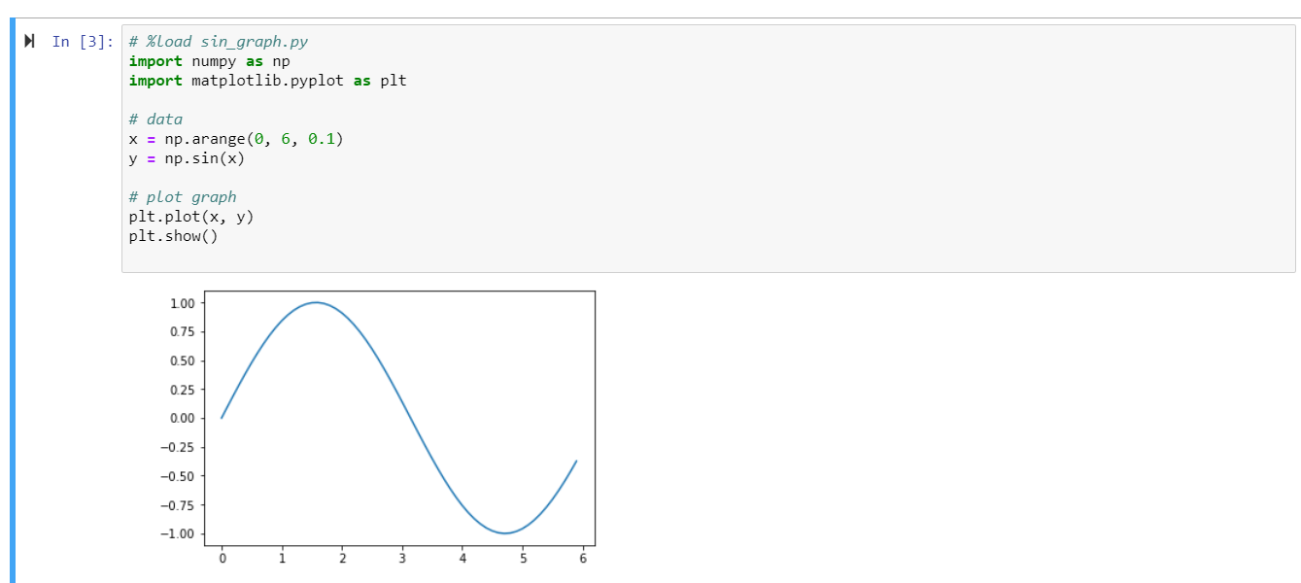
Python programming
# %load sin_graph.py
import numpy as np
import matplotlib.pyplot as plt
# data
x = np.arange(0, 6, 0.1)
y = np.sin(x)
# plot graph
plt.plot(x, y)
plt.show()
http://jupyter.org/try

Slide 14
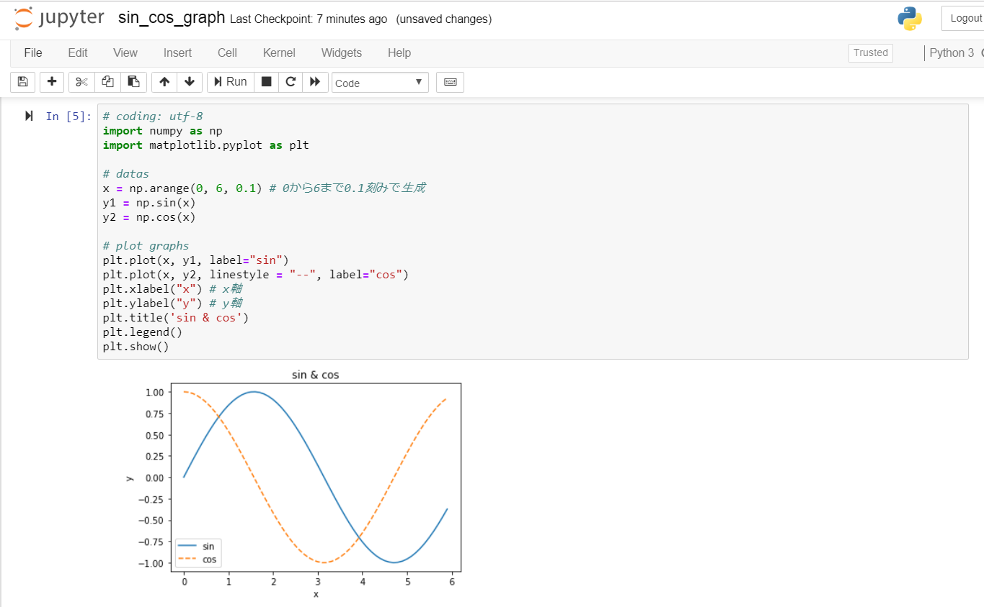
Python programming
http://jupyter.org/try
# coding: utf-8
import numpy as np
import matplotlib.pyplot as plt
# datas
x = np.arange(0, 6, 0.1) # 0から6まで0.1刻みで生成
y1 = np.sin(x)
y2 = np.cos(x)

Slide 15
Python programming
http://jupyter.org/try
# plot graphs
plt.plot(x, y1, label="sin")
plt.plot(x, y2, linestyle = "--", label="cos")
plt.xlabel("x") # x軸
plt.ylabel("y") # y軸
plt.title('sin & cos')
plt.legend()
plt.show()

Slide 16
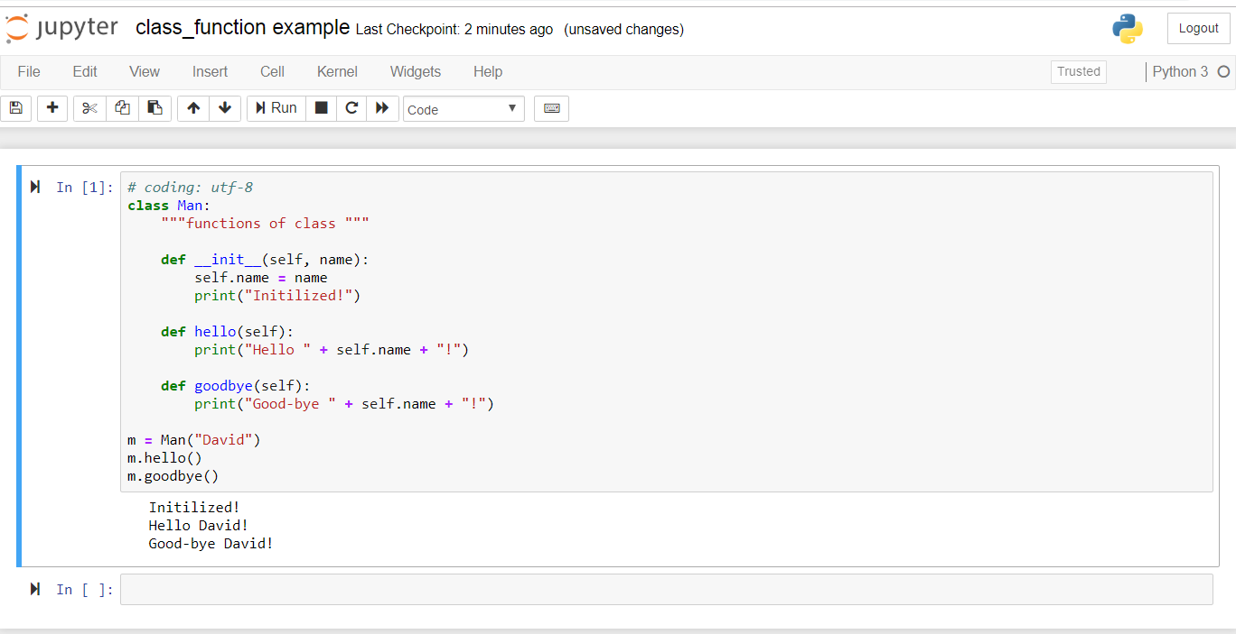
Python programming
http://jupyter.org/try
class Man:
"""functions of class """
def __init__(self, name):
self.name = name
print("Initilized!")
def hello(self):
print("Hello " + self.name + "!")
def goodbye(self):
print("Good-bye " + self.name + "!")

Slide 17
Python programming
http://jupyter.org/try
m = Man("David")
m.hello()
m.goodbye()

Slide 18
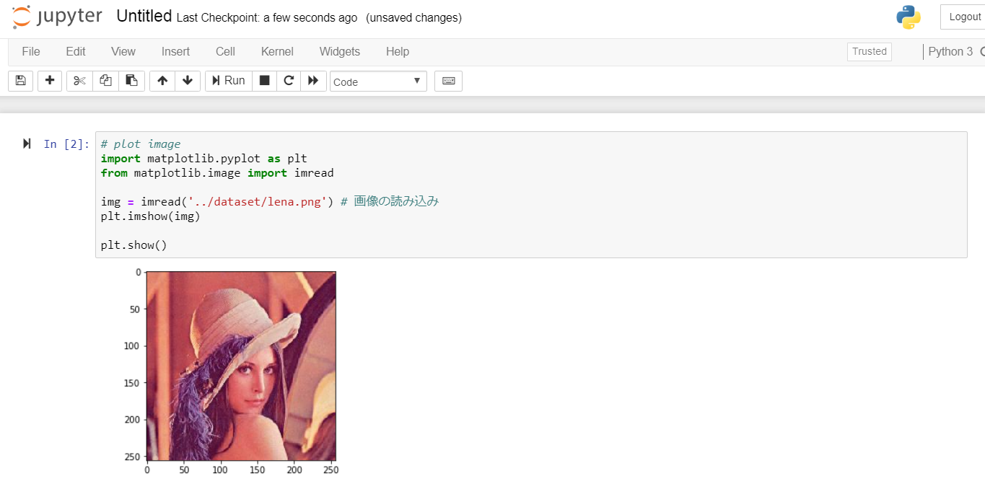
Python programming
http://jupyter.org/try
# plot image
import matplotlib.pyplot as plt
from matplotlib.image import imread
img = imread('../dataset/lena.png') # 画像の読み込み
plt.imshow(img)
plt.show()

Slide 19
Python programming
http://jupyter.org/try
Question:
Design a Class
With functions
plotsin()
plotsincos()
Plotimage()

Slide 20
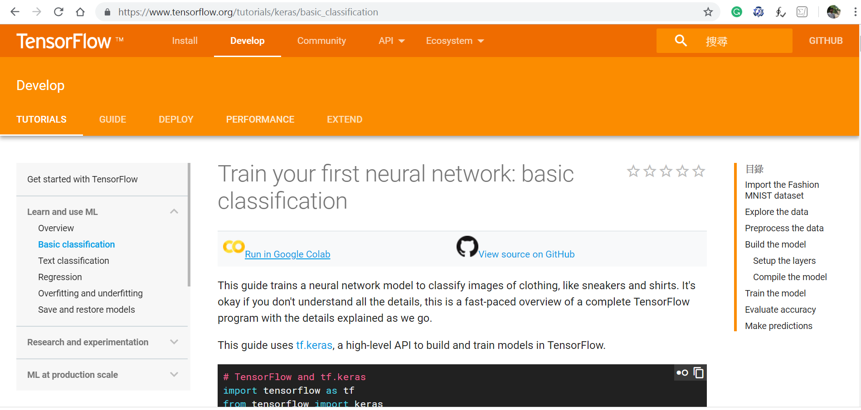
Python programming
Train your first neural network:
basic classification
Run in Google Colab
https://www.tensorflow.org/tutorials/keras/basic_classification

Slide 21
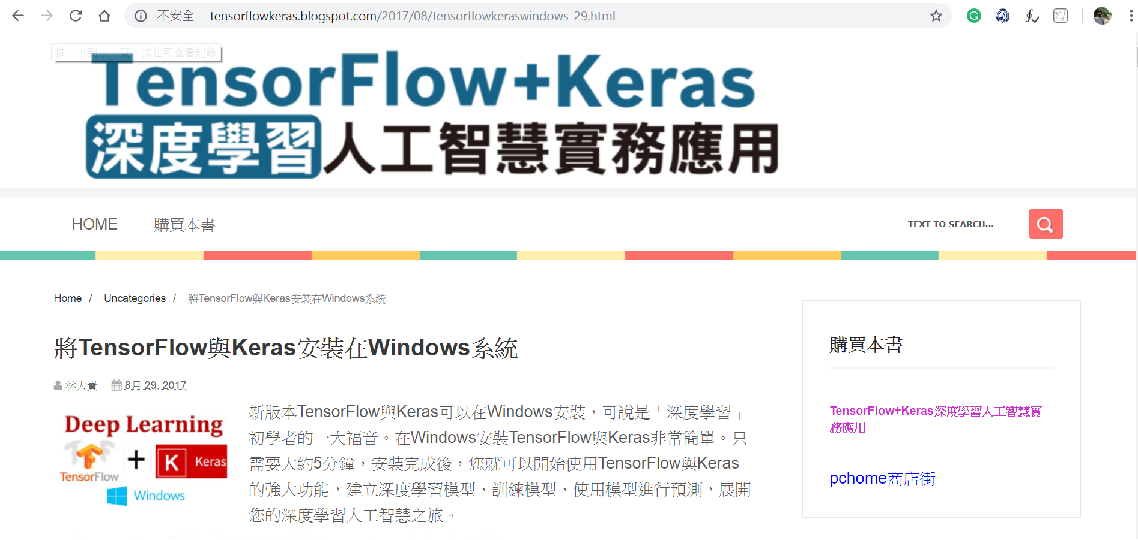
Python programming
TensorFlow+Keras
深度學習人工智慧實務應用
載範例程式（用下列URL） http://www.drmaster.com.tw/download/example/MP21710_example.zip

Slide 22
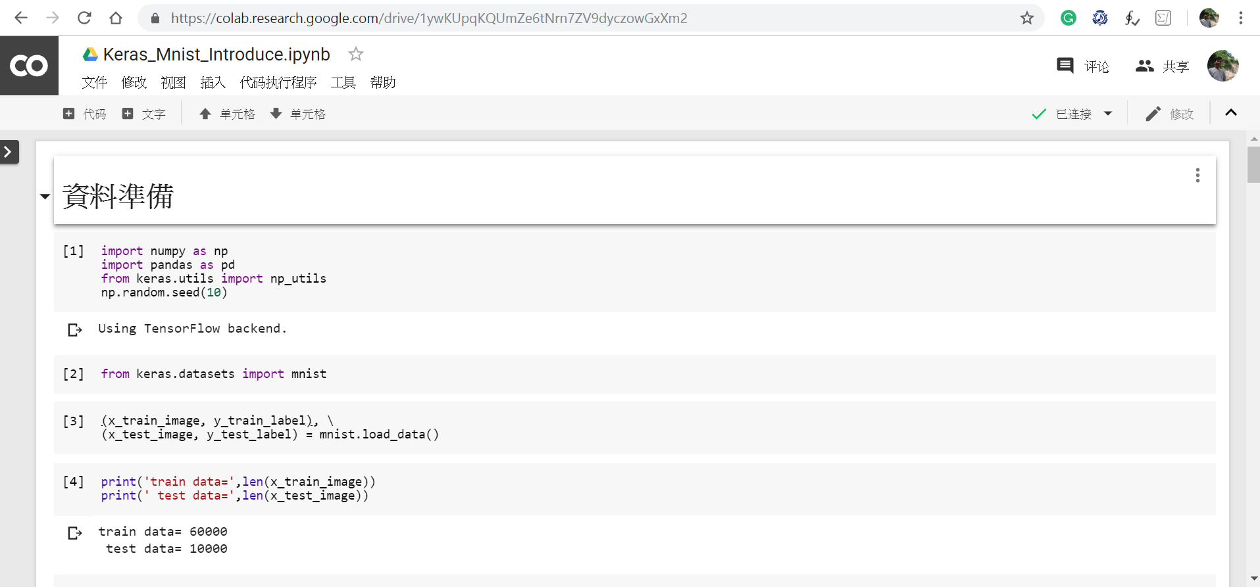
Python programming
Upload
Keras_Mnist_Introduce.ipynb
載範例程式（用下列URL） http://www.drmaster.com.tw/download/example/MP21710_example.zip

Slide 23
Python programming
Upload
Keras_Mnist_MLP_h256.ipynb
載範例程式（用下列URL） http://www.drmaster.com.tw/download/example/MP21710_example.zip

Slide 24
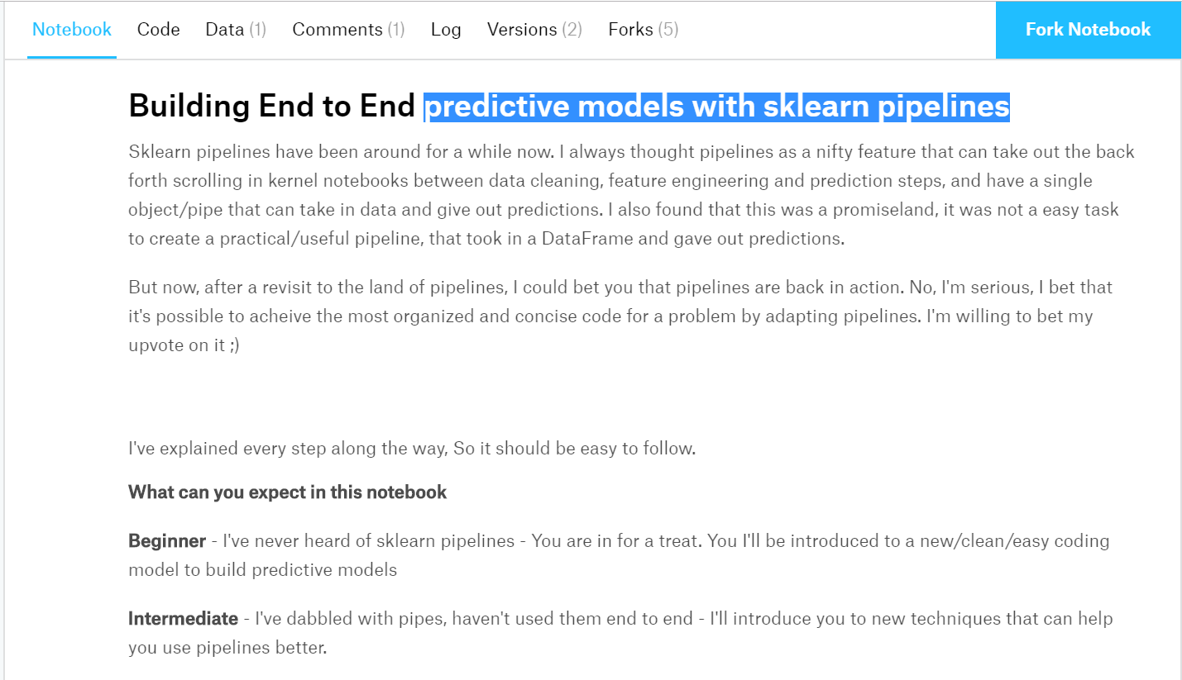
Python programming
predictive models with sklearn pipelines
https://www.kaggle.com/gautham11/building-predictive-models-with-sklearn-pipelines

Slide 25
Python programming
How to predict input image using trained model in Keras?
https://stackoverflow.com/questions/43469281/how-to-predict-input-image-using-trained-model-in-keras

